Slide 1
Express JS
Cont..

Slide 2
CRUD Operations
Create:
Insert Document – Demo
Mongoose library offers several functions to perform various CRUD (Create-Read-Update-Delete) operations.
Inserting a document into the collection
To insert a single document to MongoDB, use the create() method. It will take the document instance as a parameter. Insertion happens asynchronously and any operations dependent on the inserted document must happen by unwrapping the promise response.

Slide 3
We can insert a new document into our myNotes Collection using the below code:
exports.newNotes = async (req, res) => {
try {
const noteObj = {
notesID: 7558, name: 'Mathan', data: 'Mongo Atlas is very easy to configure and use.',
};
const newNotes = await NotesModel.create(noteObj); console.log(newNotes);
}
catch (err) {
console.log(err.errmsg);
}
};

Slide 4
In line 1, a new async function newNotes is created with request and response objects as parameters.
In line 3, a new object is created with the name noteObj with all the necessary keys that need to be inserted.
In line 8, we are referring to the NotesModel which we had created previously, and then making use of the create() method to insert the document into the collection. This will insert the documents into the collection based on the schema and will return the documents which got inserted to the const newNotes.

Slide 5
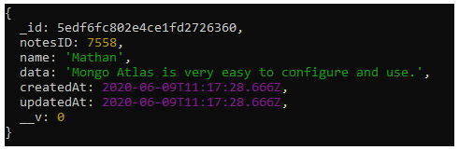
Try catch block will ensure all the exceptions are handled in the code.
In line 9, after successful insertion, you will get the following output in the console:

Slide 6
Insert multiple documents – Demo
In order to insert multiple documents into a collection, we can use any one of the following two methods: insert() or insertMany(). The syntax for inserting multiple documents into a collection is:
Model.insert([document1, document2]);
or
Model.insertMany([document1, document2]);

Slide 7
Let us now insert more documents into our myNotes collection using the below code:
exports.newNotes = async (req, res) => {
try {
const noteObj = [
{notesID: 7555, name: 'Mathan', data: 'This includes macOS package notarization and a change in configuration... ', },
{notesID: 7556, name: 'Sam', data: 'AMD processor support in android studio.', },
{notesID: 7557, name: 'Mathan', data: 'MERN', },
];
const newNotes = await NotesModel.create(noteObj); console.log(newNotes);
}
catch (err) {
console.log(err.errmsg);
}
};

Slide 8
In line 1, a new async function newNotes is created with request and response objects as parameters.
In line 3, a new array of objects is created with the name noteObj with all the necessary keys that need to be inserted.
In line 16, we are referring to the same NotesModel which we had created earlier. We can now make use of the create() method to insert the documents into the collection. It will insert the documents into the collection based on the schema and will return the documents which got inserted to the const newNotes.
Try catch block will ensure all the exceptions are handled in the code.

Slide 9
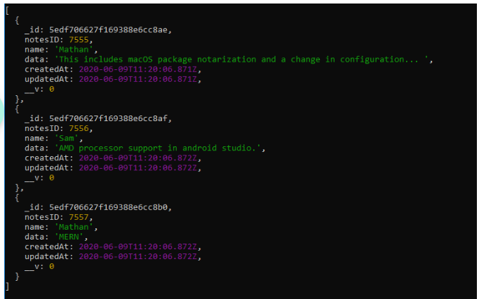
In line 17, after successful insertion, you will get the following output in the console:

Slide 10
Read document(s)
Documents can be retrieved through find, findOne, and findById methods.
Let us now retrieve all the documents that we have inserted into our myNotes Collection.
exports.getNotes = async (req, res) => { try {
const notes = await NotesModel.find({},
{ _id: 0, __v: 0 });
if(notes.length > 0) {
console.log(notes);
}
}
catch (err) {
console.log(err.errmsg);
}
};

Slide 11
In line 1, a new async function getNotes is created with request and response objects as parameters.
In line 3, we are referring to the same NotesModel which we had created earlier and made use of the find() method to fetch the document(s) from the collection. The retrieved documents will be available in the const notes.
In line 4, we are ensuring the data by checking the length and displaying the returned data in the console.
Try catch block will ensure all the exceptions are handled in the code.

Slide 12
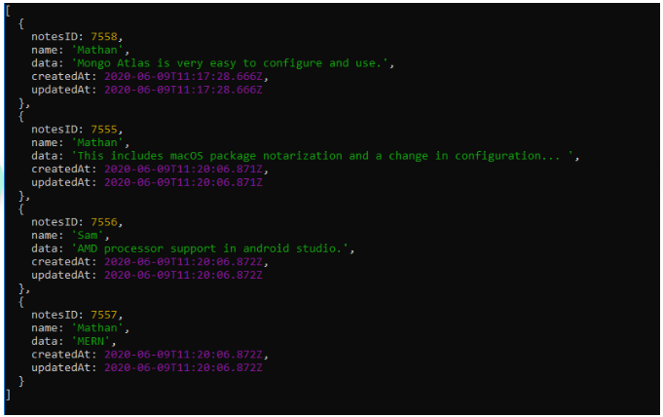
On successful retrieval of the documents, you will get the following output in the console:

Slide 13
Retrieving data based on the condition
Let us try to retrieve notes details based on notesID from the myNotes Collection using the below code:
exports.getNotes = async (req, res) => { try {
const notes = await NotesModel.find({ notesID: 7555 },
{ _id: 0, __v: 0 });
if (notes.length > 0)
{ console.log(notes); }
}
catch (err) {
console.log(err.errmsg); }
};

Slide 14
In line 1, a new async function getNotes is created with request and response objects as parameters.
In line 3, we are referring to the same NotesModel which we had created earlier and made use of the find() method to fetch the document(s) from the collection by providing the condition(s) based on which documents should be retrieved. The retrieved documents will be available in the const notes.
In line 4, we are ensuring the data by checking the length and displaying the returned data in the console.
Try catch block will ensure all the exceptions are handled in the code.

Slide 15
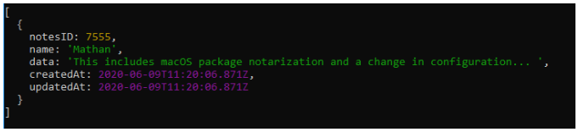
On successful retrieving of the document, you will get the following output in the console:

Slide 16
Update document(s)
We will update the details of the myNotes collection using the below code:
exports.updateNotes = async (req, res) => {
try {
const noteObj = {
name: 'Mathan',
data: 'Updated notes',
};
const notes = await NotesModel.findOneAndUpdate(
{ notesID: 7555 },
noteObj,
{
new: true, //to return new doc back
runValidators: true, //to run the validators which specified in the model
}
);

Slide 17
if (notes != null) {
console.log(notes);
}
}
catch (err) {
console.log(err.errmsg);
}
};

Slide 18
In line 1, a new async function updateNotes is created with request and response objects as parameters.
In line 3, a new array of objects is created with the name noteObj with all the necessary keys that need to be updated.
In line 8, we are referring to the same NotesModel which we had created earlier and made use of the findOneAndUpdate() method to find and update one document in the collection. It will update the document in the collection based on the schema and will return the document which got updated to the const notes.

Slide 19
The parameters of findOneAndUpdate() method are:
The condition based on which the document should be updated.
The new values to be updated.
Additional options to return the updated document and to validate the values based on the schema definition.
Try catch block will ensure all the exceptions are handled in the code.

Slide 20
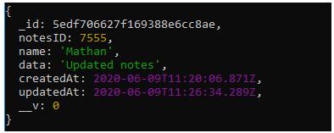
In line 18. On successful updating of the document, you will get the following output in the console.

Slide 21
Delete document(s)
The below code shows how to delete the contents of myNotes collection:
exports.deleteNotes = async (req, res, err) => {
const delDet = await NotesModel.deleteOne({
notesID: 7555 });
console.log(delDet);};
In line 1, a new async function deleteNotes is created with the request, response, and error objects as parameters.

Slide 22
In line 2, we are referring to the same NotesModel which we had created earlier and made use of deleteOne() method to delete the document from the collection based on the condition and will return the details about the delete operation performed, which is initialized to the const delDet.
In line 3, on the successful deletion of the document, you will get the following output in the console.

Slide 23
API Development
Introduction
We are going to learn how to create a set of APIs with all CRUD operations.
This project covers the following:
Create a web server
Routing
Middleware
Database connectivity to MongoDB using mongoose

Slide 24
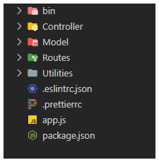
A typical folder structure with all the necessary folders will look like the below image:

Slide 25
The following describes the folder structure of the project:
Controller – Business logic and Database operations of the application.
Model – MongoDB schema and model.
Routes - All the routes that are created for the application.
Utilities – Helper files for the application. E.g. Custom validators, loggers, etc.
app.js – The starting point of the application.

Slide 26
app.js file
Application execution will start from the app.js file.
All the necessary imports and middlewares need to be configured in this file.
In the app.js, include the following code:
const express = require('express');
const bodyparser = require('body-parser');
const myReqLogger = require('./Utilities/requestLogger');
const route = require('./Routes/routing');
const app = express();
app.use(bodyparser.json());
app.use(myReqLogger);
app.use('/', route);
const port = process.env.PORT || 3000;
app.listen(port, () => { console.log(`App running on port ${port}...`);
});

Slide 27
API Routes
In the Routes folder, create a file with the name "routing.js".
This file contains route definitions for all the APIs of the application.
const express = require('express');
const routing = express.Router();
const notesController = require('../Controller/myNotes');
routing.get('/notes', notesController.getNotes);
routing.post('/notes', notesController.newNotes);
routing.put('/notes/:id', notesController.updateNotes);
routing.delete('/notes/:id', notesController.deleteNotes);
routing.all('*', notesController.invalid); module.exports = routing;

Slide 28
Model
In the Model folder, create a file with the name "myNotesSchema.js".
Logic to connect to MongoDB using mongoose, schema, and the model creation logic will be included in this file.
const mongoose = require('mongoose');
mongoose .connect('mongodb://localhost:27017/IntellectNotes',
{ useNewUrlParser: true, useCreateIndex: true, useFindAndModify: false, useUnifiedTopology: true, })
.then(() => console.log('DB connection successful!'));
//Schema
const myNotesSchema = new mongoose.Schema(
{ notesID: { type: Number, unique: true, required: [true, 'Required field'], },
name: { type: String, required: [true, 'Required field'], }, data: { type: String, },
},
{ timestamps: { createdAt: true, updatedAt: true, }, }); //Model
const NotesModel = mongoose.model('mynotes', myNotesSchema);
module.exports = NotesModel;

Slide 29
Controllers
In the Controller folder, create a file with the name "myNotes.js".
This file contains business logic for all the APIs of the application.
Custom validators will be imported and accessed based on the requirement.
All the controllers will send the response back to the client based on the request received. Error handling also is taken care of accordingly.
const NotesModel = require('../Model/myNotesSchema');
const validators = require('../Utilities/validator');
exports.getNotes = async (req, res) => {
try { const notes = await NotesModel.find({}, { _id: 0, __v: 0 });
if (notes.length > 0) {
res.status(200).json({ status: 'success', results: notes.length, data: { notes, },
}); }
else { res.status(400).json({ status: 'success', data: { message: 'No notes available in the repo', },
}); } }

Slide 30
catch (err) {
res.status(404).json({ status: 'fail', message: err, }); }};
exports.newNotes = async (req, res) => {
try {
if (validators.ValidateName(req.body.name)) {
const newNotes = await NotesModel.create(req.body); res.status(201).json({ status: 'success', data: { newNotes, },
}); }
else { res.status(400).json({ status: 'error', results: 'Enter valid name', }); } } catch (err) { res.status(404).json({ status: 'fail', message: err.errmsg, }); }}; exports.updateNotes = async (req, res) => { try { const notes = await NotesModel.findOneAndUpdate( { notesID: req.params.id }, req.body, { new: true, //to return new doc back runValidators: true, //to run the validators which specified in the model } );

Slide 31
if (notes != null) { res.status(200).json({ status: 'success', data: { notes, }, }); } else { res.status(400).json({ status: 'success', data: { message: `No notes available with ID ${req.params.id} `, }, }); } } catch (err) { res.status(404).json({ status: 'fail', message: err, }); }}; exports.deleteNotes = async (req, res) => { const delDet = await NotesModel.deleteOne({ notesID: req.params.id }); if (delDet.deletedCount === 0) { res.status(404).json({ status: 'fail', message: 'No notes available for this ID', }); } else { res.status(200).json({ status: 'success', message: `Notes with ${req.params.id} ID deleted`, }); }}; exports.invalid = async (req, res) => { res.status(404).json({ status: 'fail', message: 'Invalid path', });};

Slide 32
Utilities
In the application, we will need specific helper files. For instance, we need to have a logger that should keep track of all the requests that comes into the application or some custom validators which we can make use in the controller.
Inside the Utilities folder create the following files with the content.
requestLogger.js
const fs = require('fs');const { promisify } = require('util'); const appendFile = promisify(fs.appendFile); async function requestLogger(req, res, next) { try { const logMessage = `${new Date()} - ${req.method} - ${req.url} \n`; await appendFile('RequestLogger.log', logMessage); next(); } catch (err) { next(err); }} module.exports = requestLogger;

Slide 33
validator.js
exports.ValidateName = function (name) { if (name.trim().length > 0) { return true; } return false;};

Slide 34
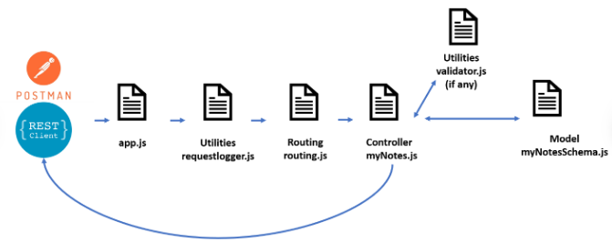
Project flow
The following figure visually explains the application data flow.

Slide 35
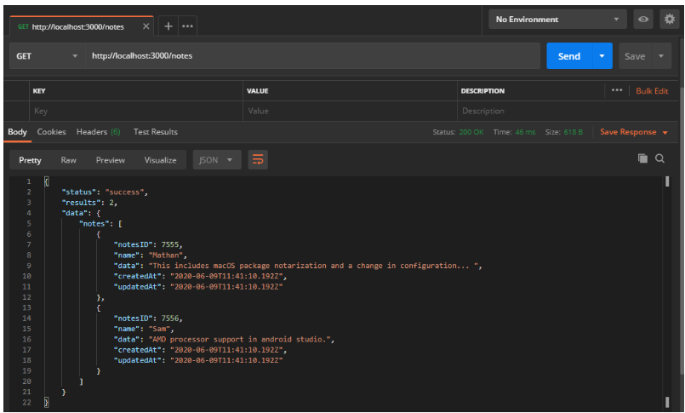
Project Execution
API – 1
URL – http://localhost:3000/notes
Method - GET
Description – API to fetch all the notes.

Slide 36
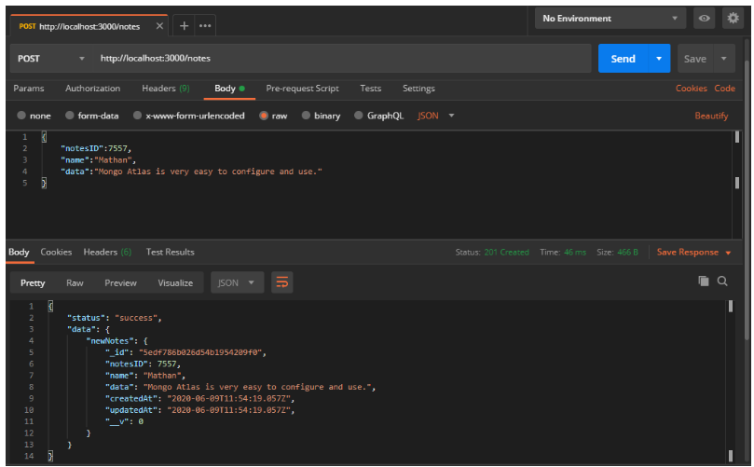
API – 2
URL – http://localhost:3000/notes
Method - POST
Description – API to add new notes.

Slide 37
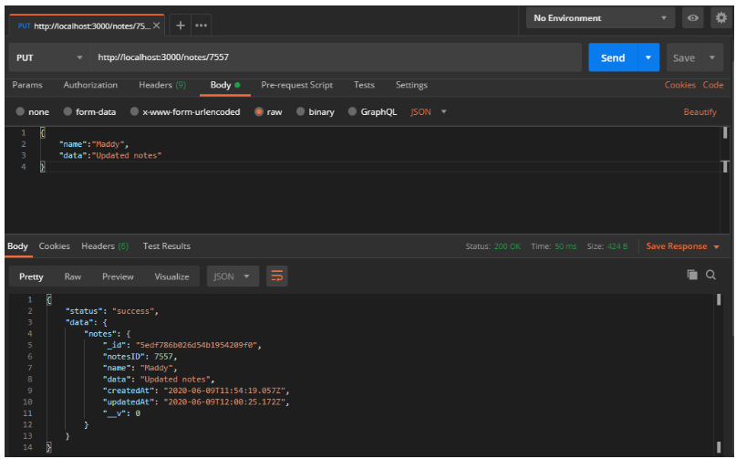
API – 3
URL – http://localhost:3000/notes/7558
Method - PUT
Description – API to update existing notes.

Slide 38
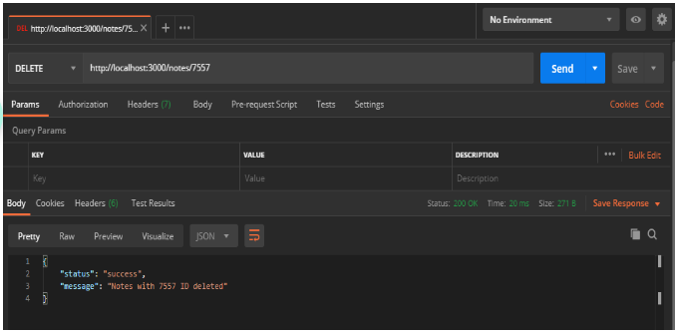
API – 4
URL – http://localhost:3000/notes/7558
Method - DELETE
Description – API to delete existing notes.

Slide 39
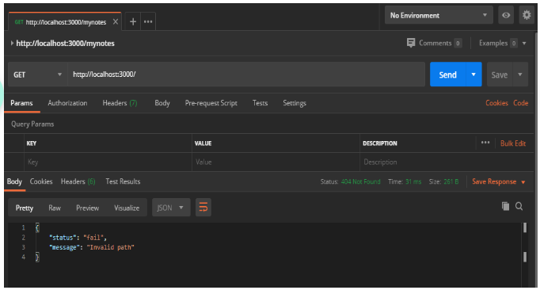
API – 5
URL – http://localhost:3000/mynotes
Method - ALL
Description – default API to handle invalid routes.

Slide 40
Why Session management?
Every user interaction with an application is an individual request and response. The need to persist information between requests is important for maintaining the ultimate experience for the user for any web application.
Session management is useful in the scenarios mentioned below:
We need to maintain that a user has already been authenticated with the application.
To retain various personalized user information that is associated with a session.
Let us now understand how we can set up sessions securely in our application to lessen risks like session hijacking.

Slide 41
Session Management is a technique used by the webserver to store a particular user's session information. The Express framework provides a consistent interface to work with the session-related data. The framework provides two ways of implementing sessions:
By using cookies
By using the session store

Slide 42
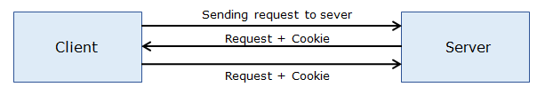
Introduction to cookies
Cookies are a piece of information sent from a website server and stored in the user's web browser when the user browses that website. Every time the user loads that website back, the browser sends that stored data back to the website server, to recognize the user.

Slide 43
Configuration
The Express framework provides a cookie API using cookieParser middleware. The middleware cookieParser parses the cookies which are attached to the request object.
To install the cookieParser middleware, issue the below command in the Node command prompt.
npm install cookie-parser
The above middleware can be configured in Express application as shown below:
const express = require('express');
const cookieParser = require('cookie-parser');
const app = express();
app.use(cookieParser());
The cookie-parser middleware is imported and then associated with the application object using the app.use() method.

Slide 44
Setting and reading cookies
Setting cookies:
routing.get('/user/:name', notesController.user1);
exports.user1 = async (req, res) => {
res.cookie('name', req.params.name);
res.send('<p>Cookie set:<a href="/user"> View here </a>');
};

Slide 45
When the user navigates to URL " /user/<username>", the cookie is set with the name username and the value is retrieved using the params property of the request object. Thus for setting cookies, the general syntax is as shown below:
res.cookie('cookieName', value, { expires: new Date(), maxAge: 99999 });
The arguments of the above method are
the name of the cookie
cookie value
the options to be used while configuring cookie, an optional object.

Slide 46
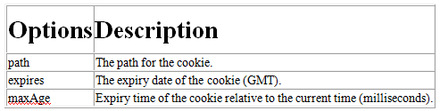
Some of the options that can be specified while configuring a cookie are shown below:

Slide 47
Reading cookies:
To access a particular cookie, use the cookies property of the request object.
exports.user2 = async (req, res) => {
res.send(req.cookies.name);
};
Whenever the user visits the "/user" route, the value of the cookie is fetched using request.cookies property and displayed to the user.

Slide 48
Updating and deleting cookies
Updating cookies:
A cookie can be updated by re-creating it with new properties. For example, if we need to update a cookie named username:
res.cookie('username', new_value)
Deleting cookies:
It is possible to remove a cookie with the response object's clearCookie() method. This method accepts the name of the cookie which we want to delete.
app.get('/user', myController.myMethod);
exports.myMethod = async (req, res) => {
res.clearCookie('username'); res.send(req.cookies.username);
};

Slide 49
Types of cookies
Session cookies
The cookies which exist for a browser session are defined as Session cookies and they are rejected whenever the browser is closed.
While configuring a cookie, if the 'expires' option is not specified with any value, then a session cookie is created by default.
res.cookie('name', 'John')
A session cookie is also created on setting value as "0" for the "expires" option.
res.cookie('name', 'John', { expires: 0 })

Slide 50
Signed cookies
The cookies which have a signature attached to its value are considered as Signed cookies. To generate this signature, any secret string value can be used while adding the cookie middleware into the application object.
A signed cookie can be created as shown below, by passing a string value while instantiating it:
app.use(cookieParser('S3CRE7'))
To access the signed cookies, use the property called signedCookies of the request object. For example, if we need to access the value of a signed cookie:
request.signedCookies.username
Session cookies are deleted on closing the browser. The other cookies are deleted on reaching the expiry date.

Slide 51
Demo of Using Cookies:
Highlights:
Session management
Use of Cookies
Download the source code for the demo here.
Demo steps:
1. Modify the app.js file in TestApp as shown below:
const express = require('express');const cookieParser = require('cookie-parser');const router = require('./Routes/routing'); const app = express();app.use(cookieParser());app.use('/', router);app.listen(3000);
console.log('Server listening in port 3000');

Slide 52
2. Modify the routing.js file in TestApp as shown below:
const express = require('express');
const myController = require('../Controller/myController');
const router = express.Router();
router.get('/user/:name', myController.user1);
router.get('/user', myController.user2);
module.exports = router;

Slide 53
3. In Controller, add the below code:
exports.user1 = async (req, res) => { res.cookie('name', req.params.name); res.send('<p>Cookie set:<a href="/user"> View here </a>');
};
exports.user2 = async (req, res) => { res.send(req.cookies.name);};

Slide 54

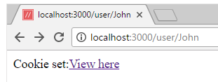
4. Save the files. Start the server.
Access the URL "http://localhost:3000/user/<username>" and observe the output.

Slide 55
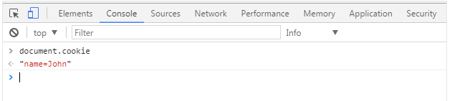
5. Open the developer tools in the browser window and click on the Console tab and type document.cookie and verify the value displayed.

Slide 56
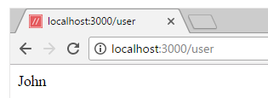
6. On click of the "View here" link, the cookie is retrieved and displayed as below:
7. Open the developer tools in the browser window and click on the Console tab and type document.cookie and verify the value displayed.

Slide 57
Sessions
Session store for session management
A session store can be used to store the session data in the back-end. Using this approach, a large amount of data can be stored, and also the data will be hidden from the user, unlike a cookie.
Configuration
Express provides a middleware called express-session for storing session data on the server-side.
To install express-session middleware, use npm.
npm install express-session

Slide 58
To use this module in the Express application, first, import it as shown below:
const session = require('express-session');
Then the session is to be initialized as follows:
app.use(session());
The session middleware also accepts an object 'options' for defining different configuration options.
app.use(session({
secret: 'keyboard',
resave: false,
saveUninitialized: true,
cookie: { secure: true }
})
);

Slide 59
secret - used for signing
resave - a boolean value which makes the session to be saved when not modified as well
saveUninitialized - a boolean value which makes the session which is uninitialized to be saved to the store
cookie - configurations for a session cookie
The built-in session store called MemoryStore is used in Express by default. But it is not suggested for use in a production environment due to memory leakage.
Express also supports the usage of any third-party module like RedisStore which stores session data in Redis, which is an in-memory data store.

Slide 60
Session Variables
Session variables are the variables that are associated with a user's session.
Consider the example code below which uses a session variable called page_views.
exports.myMethod = async (request, response) => { if (request.session.views) { request.session.views++; response.send(`You visited this page ${request.session.views} times`); } else { request.session.views = 1; response.send('Welcome to this page for the first time!'); }};

Slide 61
According to the above code snippet, a session variable called views is created when the user visits the website. The session variable is updated accordingly, whenever the user comes next time.
The session variables are set independently for each user and it can be accessed using the session property of the request object as shown below:
request.session
Setting session variables
A session variable can be set by attaching it to the request object either using the dot notation or the substring syntax.
request.session.username = 'John';request.session['username'] = 'John';

Slide 62
Reading session variables
To read a session variable, use the request object as shown below:
const username = request.session.usernameconst username = request.session['username']
Updating session variables
A session variable can be updated using the req.session object or use a new value to overwrite the existing one.
request.session.username.push('value');request.session.username = 'John';

Slide 63
Demo- Using Session store
Highlights:
Session management
Usage of the Session store
Download the source code for the demo here.
Demo steps:
1. Open the TestApp folder in the command prompt and run the command "npm install" for installing the dependencies mentioned in the package.json file.
2. In the file server-session.js, use the below code:
const express = require('express'); const app = express();const session = require('express-session'); app.use( session({ name: 'my-session', cookie: {

Slide 64
//Current Server time + maxAge = expire datetime maxAge: 1000 * 60, //Allows for the cookie to be read only by a server (no JS) httpOnly: true, //Set for the root of the domain. path: '/', }, secret: 'mypasswordinfy', })); app.use((req, res, next) => { let { visit } = req.session;

Slide 65
if (!visit) { visit = req.session.visit = { count: 1, }; } else { visit.count++; } next();}); app.get('/', (req, res) => { res.send(`you viewed this page ${req.session.visit.count} times`);}); app.listen(3000);console.log('Server started...running with port 3000');

Slide 66

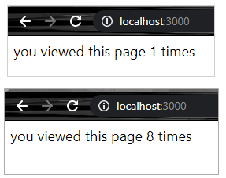
2. Start the Server.
3. Observe the below output:

Slide 67
Securing Express applications
Why Security?
Attackers may attempt to exploit security vulnerabilities present in web applications in various ways. They may plan attacks like clickjacking, cross-site scripting, placing insecure requests and identifying web application frameworks etc.
It is important to follow secure coding techniques for developing secure, robust and hack-resilient applications.

Slide 68
What is Security?
Security is basically about protecting the application assets like the web page, the database, and so on.
Security depends on the following elements:
Authentication: the process of exclusively identifying the clients of your applications and services.
Authorization: a process that manages the resources and operations that the authenticated user is permitted to access.
Auditing: process to assure that a user cannot deny performing an operation or initiating a transaction.
Confidentiality: the process of making sure that data remains private and confidential.
Integrity: the promise that data is protected from malicious modification.
Availability: means that systems remain available for legitimate users.

Slide 69
Use of Helmet Middleware
Express applications can be secured by using a middleware called helmet.
The helmet middleware is a set of 14 small middleware functions that help in setting up security-related HTTP headers with default values and also removes unnecessary headers which expose the application related information.
Below are the set of middleware functions that helmet provides to protect an Express application:

Slide 70
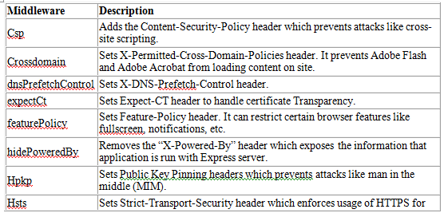

Slide 71
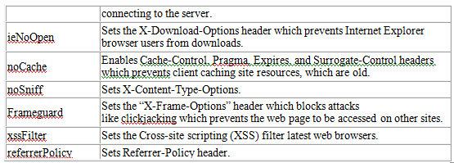
Best Practices Tip: Use Helmet if you’re writing a web app
If you’re writing a web application, there are a lot of common best practices that you should follow to secure your application as mentioned in the above list.

Slide 72
Helmet configuration
To install helmet in any Express application, use node package manager and run the below command.
npm install helmet
Once helmet is installed, it is to be associated with the Express application object.
var helmet = require('helmet');
app.use(helmet());
Express also provides the option of enabling pieces of helmet middleware individually as shown below.
app.use(helmet.noCache());app.use(helmet.frameguard());

Slide 73
It also provides the functionality of disabling a middleware that's normally enabled by default based on the application requirement.
For example, frameguard middleware mitigates clickjacking attacks by setting a header 'X-Frame-Options'. For disabling this middleware in the helmet stack, modify the code as shown below.
app.use(helmet({ frameguard: false}));

Slide 74
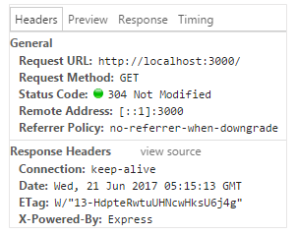
Benefit of using Helmet Middleware
Consider an Express application server code that does not have helmet middleware added.
Once the server is started and when the client sends a request to the server, have a look at the headers generated as part of the response.

Slide 75
When any request is sent to the server from a client, the server will process the request and sends the response back to the client without any protections that the helmet middleware could have possibly provided, if it was used.
In the above response headers, we can see a header "X-Powered-By" with the value as "Express". From this, we can understand that the application is running on an Express server. We can also see that there are no clickjacking protections available and no cache control headers are set for the application.

Slide 76
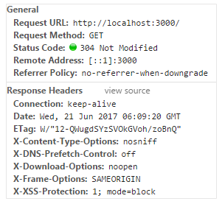
Now if the helmet middleware was used, here's what the response headers would look like:

Slide 77
We can see that some extra headers get set.
The X-Content-Type-Options header is set to value nosniff. This does not allow the browser to guess the MIME type of a file.
The X-Download-Options header is set to value noopen. This disables the option to open a file directly on download.
The X-Frame-Options header is set to value SAMEORIGIN. This is used to indicate whether a browser should be allowed to render a page within a <frame> or <iframe>, but only from the originating host.
The X-XSS-Protection header is set to value 1; mode=block. This instructs Internet Explorer to enable the anti-cross-site scripting filter.
The X-Powered-By header is removed so that the attackers cannot see which server is used for running the application.

Slide 78
Thank You

